Slide 1




INTRODUCTION
TO
MULTIMEDIA

Slide 2
Learning outcomes
At the end of the topic, the students must have:
1. Defined what is Multimedia.
2. Familiarized the different tools in Multimedia.
3. Identified the different elements or components of Multimedia.

Slide 3
What is multimedia?
Multimedia is an interactive medium that offers a variety of powerful ways to represent information to the user. It allows users to interact with digital information. It serves as a means of communication. Education, training, reference material, business presentations, advertising, and documentaries are some of the industries that make extensive use of multimedia.

Slide 4
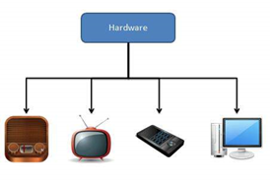
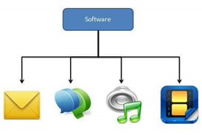
What is multimedia? (cont..)
As the name implies, multimedia is a combination of multi and media, which refers to various types of media (hardware/software) used for information communication.
Notes:
Multimedia, in other words, is a computerized method of presenting information that combines textual data, audio, visuals (video), graphics, and animations.

Slide 5
components of multimedia?
Following are the common components of multimedia:
Text- Text is present in all multimedia productions. To suit the professional presentation of the multimedia software, the text can have a variety of fonts and sizes.
Notes:
MS Trebuchet, ITC Avant Garde Gothic, MS Arial, MS Verdana, Univers, Futura, ITC Stone Sans, Gill Sans, Akzidenz Grotesk, Helvetica.

Slide 6
components of multimedia?
Graphics- Graphics enhance the appeal of the multimedia application. In many cases, people dislike reading large amounts of text on a screen. As a result, graphics are used more frequently than text to explain a concept, present background information, and so on. Graphics are classified into two types:

Slide 7

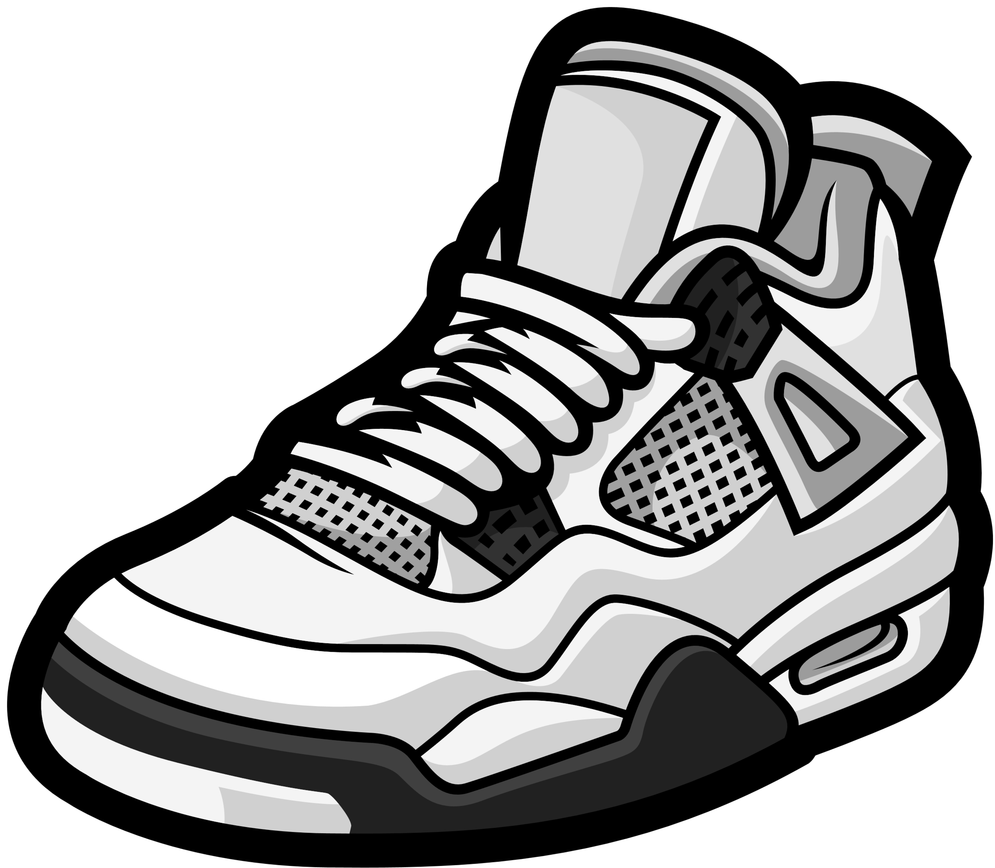
components of multimedia?
o Bitmap images- Bitmap images are actual images that can be captured using devices like digital cameras or scanners. Bitmap images, in general, cannot be edited. Bitmap images require a lot of memory.
o Vector Graphics- Vector graphics are created on a computer and require very little memory. These graphics can be customized.
example

Slide 8
components of multimedia?
Audio- Speech, music, and sound effects may be required in a multimedia application. These are referred to as audio or sound elements of multimedia. Speech is also an excellent medium for instruction. Analog and digital audios exist. The original sound signal is referred to as analog audio or sound. The sound is digitally stored on the computer. As a result, digital audio is used in multimedia applications.

Slide 9
components of multimedia?
Video- The term video refers to a moving picture that is accompanied by sound, such as a television picture. The video component of a multimedia application provides a lot of information in a short period of time. Digital video can be used in multimedia applications to display real-world objects. When uploaded to the internet, videos place the greatest demand on computer memory and bandwidth.

Slide 10
components of multimedia?
Animation- Animation is the process of making a static image appear to move. An animation is simply a continuous series of still images displayed in a sequential order. The animation can be used to effectively draw attention. Animation also makes a presentation livelier and more appealing. Animation is widely used in multimedia applications.

Slide 11
Applications of Multimedia

Slide 12
Applications of Multimedia
Following are the common areas of applications of multimedia.
·Multimedia in Business- Multimedia can be used in a variety of business applications. Multimedia and communication technology have paved the way for global work groups to share information. Today's team members can work from anywhere and for a variety of companies. As a result, the workplace will become global.

Slide 13
Applications of Multimedia
Multimedia in Marketing and Advertising- New product marketing can be greatly enhanced by using multimedia. The use of multimedia to improve communication at a low cost paved the way for marketing and advertising personnel. Flying banners, video transitions, animations, and sound effects are some of the elements used in creating a multimedia-based advertisement to appeal to consumers in novel ways and promote the sale of products.

Slide 14
Applications of Multimedia
Multimedia in Entertainment - Multimedia significantly enhances the entertainment experience across various platforms. In movies and television, visual effects and sound design create immersive worlds. In music, digital formats and music videos leverage multimedia for a dynamic experience. Video games benefit from high-quality graphics and interactive sound. Virtual and augmented reality technologies offer immersive experiences. Interactive websites and apps engage users with multimedia content, and live performances utilize multimedia elements to captivate audiences. Overall, multimedia continues to play a pivotal role in pushing the boundaries of creativity and technology in the entertainment industry.
Notes:
In movies and television, visual effects and sound design create immersive worlds. In music, digital formats and music videos leverage multimedia for a dynamic experience. Video games benefit from high-quality graphics and interactive sound.

Slide 15
Applications of Multimedia
Multimedia in Education- Many educational computer games are now available. Consider an educational game that plays various rhymes for children. Apart from playing the rhymes, the child can paint pictures, change the size of various objects, and so on. Several other multimedia packages are available on the market that provide children with a wealth of detailed information and play capabilities.
Notes:
Apart from playing the rhymes, the child can paint pictures, change the size of various objects, and so on.

Slide 16
Applications of Multimedia
Multimedia in Bank- Another public place where multimedia is finding increasing use in recent years is the bank. People go to banks to open savings/current accounts, deposit funds, withdraw money, learn about the bank's various financial schemes, and obtain loans, among other things. Every bank has a wealth of information that it wishes to share with its customers. It can use multimedia in a variety of ways for this purpose. The bank also displays information about its various schemes on a PC monitor in the customer rest area. Online and internet banking are now very popular. These make extensive use of multimedia. Thus, multimedia is assisting banks in providing service to their customers as well as educating them about the banks' appealing finance schemes.

Slide 17
Applications of Multimedia
Multimedia in Hospital- In hospitals, multimedia is best used for real-time monitoring of patients' critical illness or accident conditions. The conditions are continuously displayed on a computer screen, and any changes on the screen can alert the doctor/nurse on duty. A surgeon or expert can watch an ongoing surgery line on his PC monitor and provide online advice at any critical juncture thanks to multimedia. In hospitals, CD-ROMs/ Cassettes/ DVDs containing multimedia-based information about various diseases and their treatment can be used to diagnose an illness. Some hospitals heavily rely on multimedia presentations to train their junior doctors and nurses. During critical surgeries, multimedia displays are now widely used.

Slide 18
Applications of Multimedia
Multimedia Pedagogues- Pedagogues are only effective teaching tools if they stimulate and motivate students. A pedagogue can benefit from audio-visual support in this regard. A multimedia tutor can present the student with a variety of challenges to pique his interest in a subject. Pedagogue instruction has progressed beyond providing only button level control to intelligent simulations, dynamic link creation, composition and collaboration, and system testing of user interactions.

Slide 19
Applications of Multimedia
Communication Technology and Multimedia Services- The advancement of high computing abilities, communication methods, and relevant standards has ushered in an era in which you will be provided with multimedia facilities at home.

Slide 20
Multimedia Systems
lesson 2

Slide 21
Learning outcomes
At the end of the topic, the students must have:
1.Familiarized the different Multimedia Hardware and Software
2.Identified the different applications of Multimedia System

Slide 22
Multimedia Hardware
·Most computers nowadays include the hardware components needed to develop and view multimedia applications. The various categories in which we can define the various types of hardware required for multimedia applications are as follows.

Slide 23
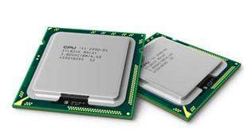
Multimedia Hardware
Processor - The heart of any multimedia computer is its processor. Today Core i5 or higher processor is recommended for a multimedia computer.
CPU is considered as the brain of the computer.
CPU performs all types of data processing operations.
It stores data, intermediate result, and instructions (program).
It controls the operations of all parts of computer.

Slide 24
Multimedia Hardware
Memory and Storage Devices - Memory is required to store various files used during production, such as original audio and video clips, edited pieces, and final mined pieces. You will also require memory to back up your project files.
Primary Memory- Only the data and instructions on which the computer is currently working are stored in primary memory. It has limited storage capacity and data is lost when the power is turned off. It is typically composed of semiconductor devices. These memories are slower than registers. Main memory stores the data and instructions that must be processed earlier. It is further subdivided into RAM and ROM.

Slide 25
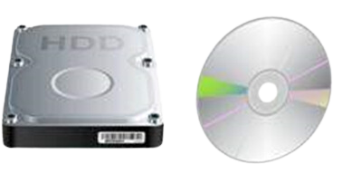
Multimedia Hardware
Flash Memory- Cache memory is a type of high-speed semiconductor memory that can help to speed up the CPU. It serves as a buffer between the processor and main memory. It is used to store data and program segments that are frequently accessed by the CPU. The operating system transfers data and program segments from disk to cache memory, where the CPU can access them.

Slide 26
Multimedia Hardware
Secondary Memory: This type of memory is also known as non-volatile memory or external memory. It operates at a slower rate than main memory. These are used to permanently store data/information. The CPU does not directly access these memories; instead, they are accessed through input-output routines. Secondary memory contents are first transferred to main memory, where they can then be accessed by the CPU. For instance, disk, CD-ROM, DVD, and so on.

Slide 27
Multimedia Hardware
Input Devices - The various types of input devices used in multimedia systems are listed below.
Keyboard- The keyboard is the most common and widely used input device. The keyboard aids in data entry into the computer. The keyboard layout is like that of a traditional typewriter, though some additional keys are provided for performing some additional functions. Keyboards come in two sizes: 84 keys or 101/102 keys, but for Windows and the Internet, 104 keys or 108 keys are also available. The keys are as follows:

Slide 28
Multimedia Hardware
Typing Keys
These keys include letter keys (A-Z) and digit keys (0-9) that have the same layout as typewriters.
Numeric Keypad
It is used to enter numerical data or move the cursor. In general, it consists of a set of 17 keys laid out in the same layout as most adding machines and calculators.
Function Keys
On the keyboard, there are twelve function keys. These are lined up along the top of the keyboard. Each function key has a distinct meaning and serves a specific purpose.

Slide 29
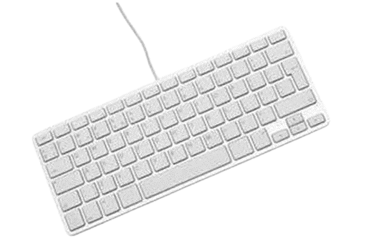
Multimedia Hardware
Control keys
These keys control the cursor and the screen. It has four directional arrow keys. Home, End, Insert, Delete, Page Up, Page Down, Control(Ctrl), Alternate(Alt), and Escape are also control keys (Esc).
Special Purpose Keys
There are also some special purpose keys on the keyboard, such as Enter, Shift, Caps Lock, Num Lock, Space bar, Tab, and Print Screen.

Slide 30
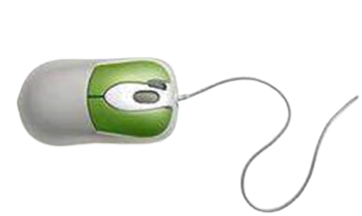
Multimedia Hardware
Mouse - The mouse is the most widely used pointing device. It is a well-known cursor-control device. It is a small palm-sized box with a round ball at its base that detects mouse movement and sends corresponding signals to the CPU when the buttons are pressed. In general, it has two buttons labeled left and right, as well as a scroll bar in the middle. The mouse can be used to move the cursor on the screen, but it cannot be used to enter text into the computer.

Slide 31
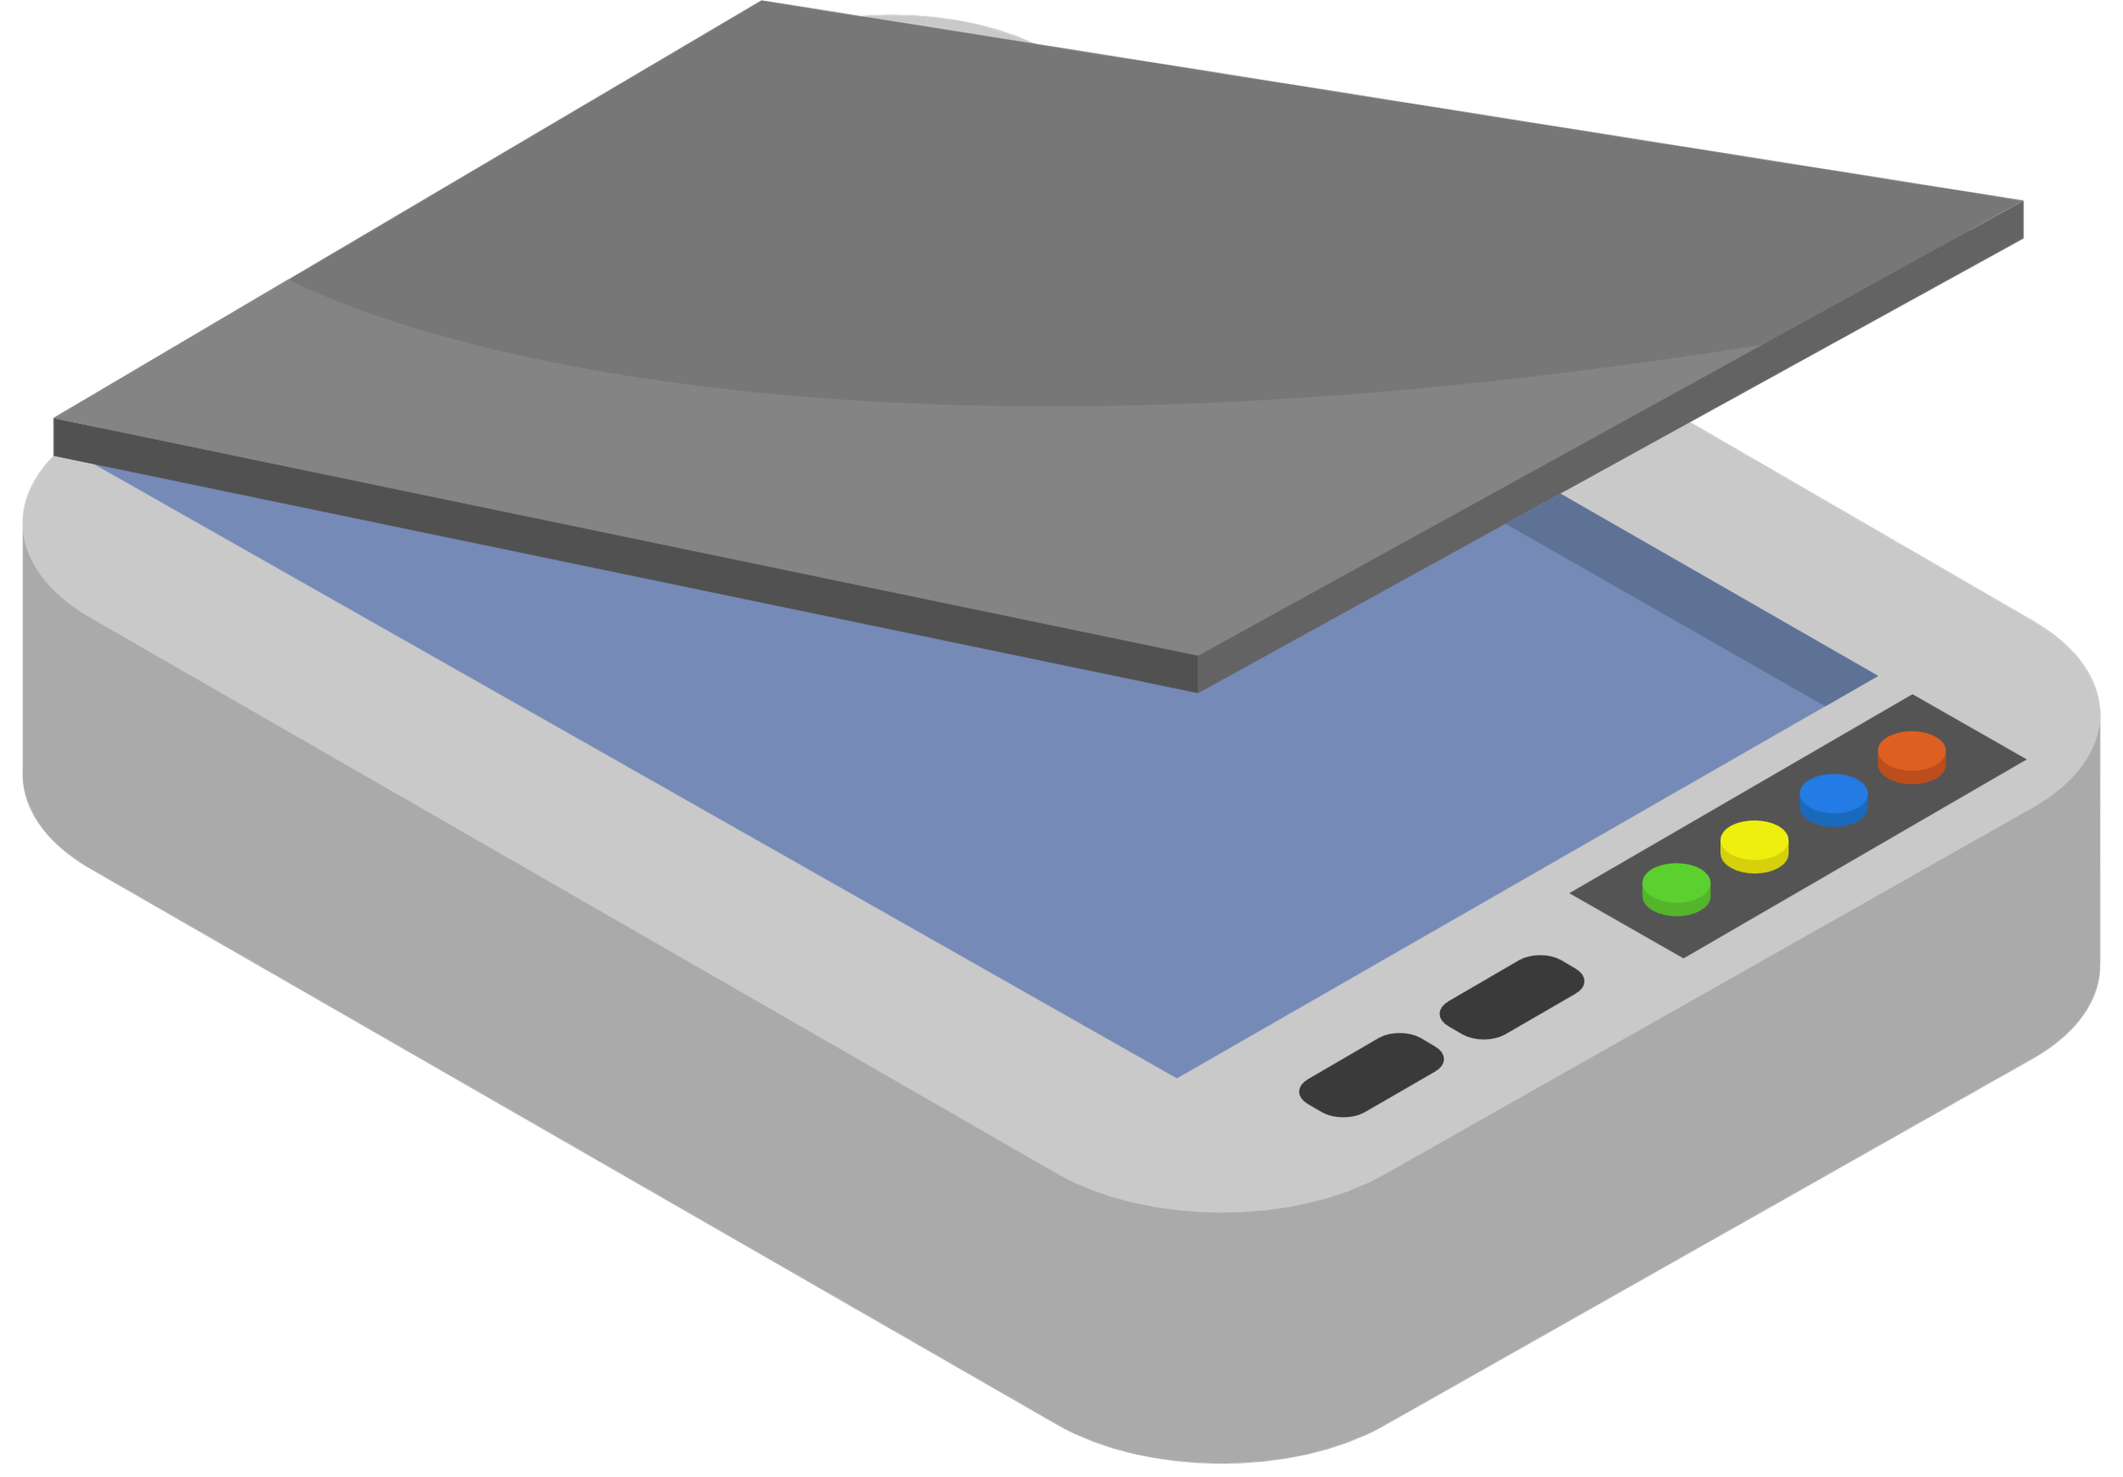
Multimedia Hardware
Scanner - A scanner is an input device that functions similarly to a photocopier. It is used when information is available on paper and needs to be transferred to the computer's hard disk for further manipulation. The scanner captures images from the source and converts them into digital files that can be stored on a disc. Before they are printed, these images can be edited.

Slide 32
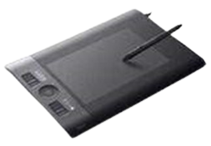
Multimedia Hardware
Digitizer - A digitizer is an input device that converts analog data to digital data. A digitizer can convert a television camera signal into a series of numbers that can be stored in a computer. The computer can use them to create a picture of whatever the camera was pointed at. Because it converts graphic and pictorial data into binary inputs, the digitizer is also known as a tablet or graphics tablet. A graphic tablet with a digitizer is used for fine drawing and image manipulation applications

Slide 33
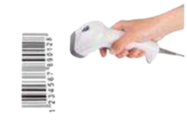
Multimedia Hardware
Bar Code Readers - A bar code reader is a device that reads bar coded data (data in form of light and dark lines). Bar coded data is commonly used in labeling goods, numbering books, and so on. Bar Code Reader scans a bar code image and converts it into an alphanumeric value, which is then fed to the computer to which the bar code reader is connected.

Slide 34
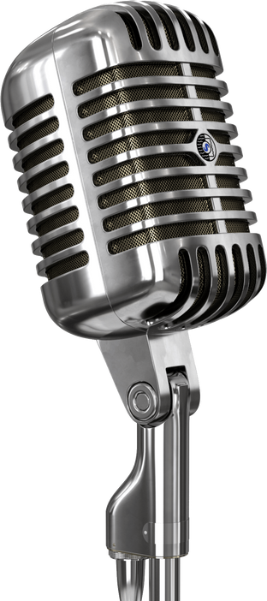

Multimedia Hardware
Voice Systems - The various types of input devices used in multimedia systems are listed below.
Microphone- A microphone is an input device that captures sound and stores it digitally. The microphone is used for a variety of purposes, such as adding sound to a multimedia presentation or mixing music.

Slide 35

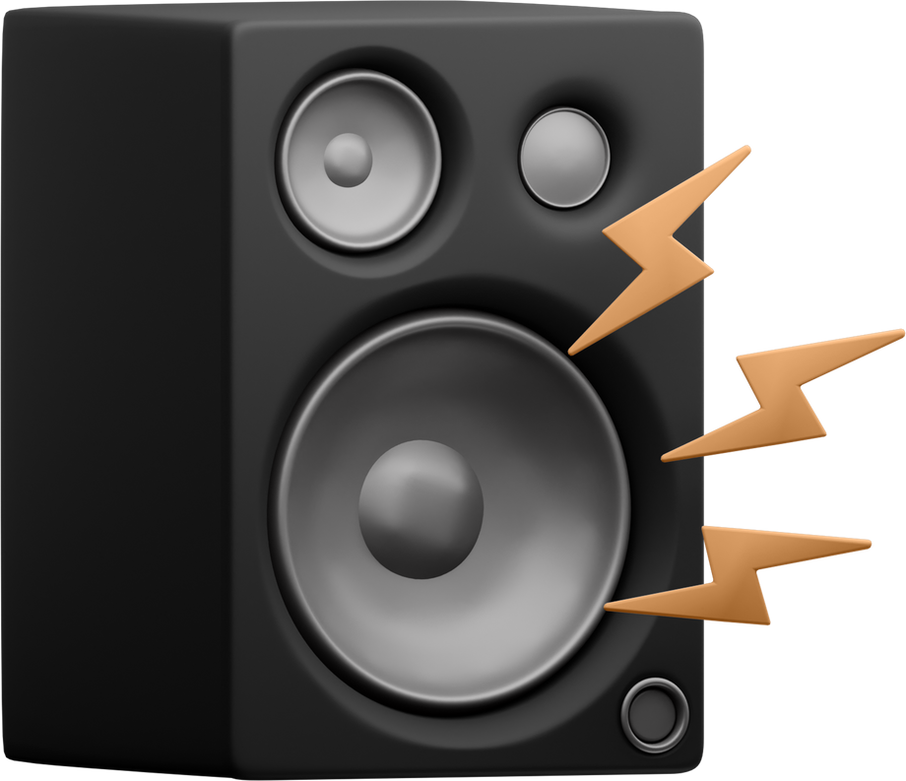
Multimedia Hardware
Speaker- A speaker is a device that produces sound that is digitally stored. The speaker is used for a variety of purposes, such as adding sound to a multimedia presentation or displaying movies, among others.

Slide 36


Multimedia Hardware
Digital Camera - A digital camera is an image input device that stores images digitally. The digital camera is used for a variety of purposes, such as adding images to a multimedia presentation or for personal use.

Slide 37

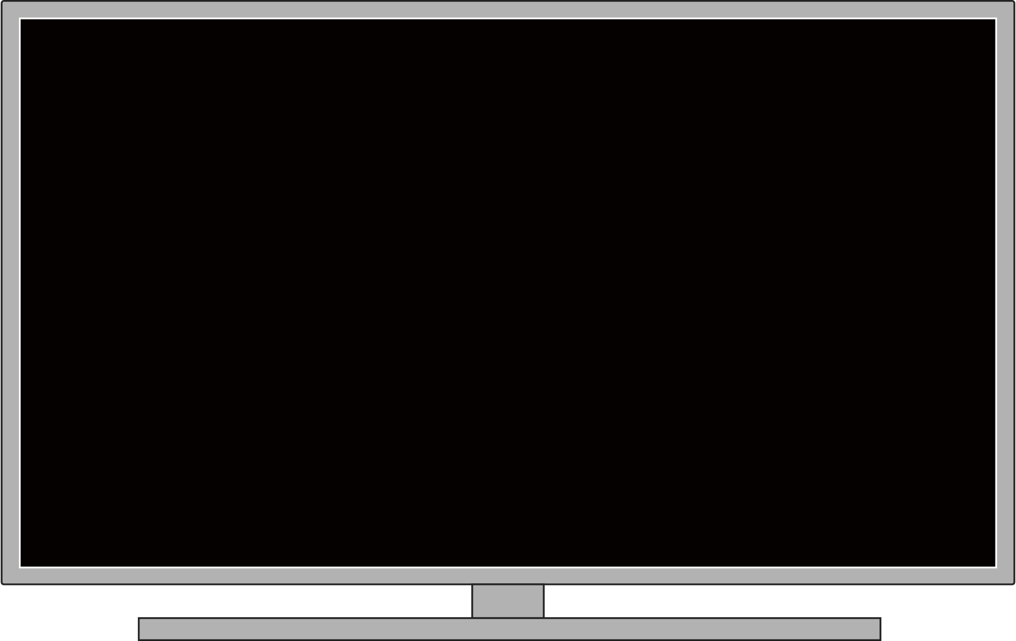
Multimedia Hardware
Output Devices - The following are a few of the most important output devices used in computer systems:
Monitors - A monitor, also known as a Visual Display Unit (VDU), is a computer's primary output device. It creates images by arranging tiny dots called pixels in a rectangular pattern. The image's sharpness is determined by the number of pixels. There are two types of monitor viewing screens:
Notes:
▪ Cathode-Ray Tube (CRT) Monitor- The display in a CRT is made up of small picture elements known as pixels for short.
▪ Flat-Panel Display Monitor- A flat-panel display is a type of video display that has a smaller volume, weight, and power requirement than a CRT.

Slide 38
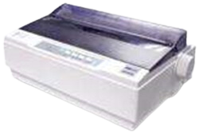
Multimedia Hardware
Printers - The printer is the most important output device for printing information on paper.
Dot Matrix Printer- Dot Matrix Printers are among the most popular printers on the market due to their ease of use and low cost. Each character printed is in the form of a Dot Matrix pattern, and the head consists of a Matrix of Pins of size (5*7, 7*9, 9*7, or 9*9) that come out to form a character, hence the name Dot Matrix Printer.

Slide 39
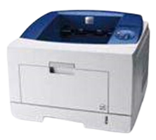
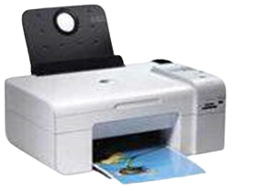
Multimedia Hardware
Laser Printers- These are page printers with no impact. They use laser lights to generate the dots necessary to form the characters that will be printed on a page.
Inkjet Printers- Inkjet printers are non-impact character printers that use a new technology. Characters are printed by spraying small drops of ink onto paper. Inkjet printers produce high-quality output with aesthetically pleasing features

Slide 40
Multimedia Software
Multimedia software instructs the hardware. For example, multimedia software instructs the hardware to display blue and play the sound of crashing cymbals. Paint Brush, Photo Finish, Animator, Photo Shop, 3D Studio, Corel Draw, Sound Blaster, IMAGINET, Apple Hyper Card, Photo Magic, Picture Publisher, and other software are available on the market to create these media elements (movies, sound, text, animation, graphics, and so on).

Slide 41
Multimedia Software Categories
Following are the various categories of Multimedia software.
·Device Driver Software- This software is used to install and configure the multimedia peripherals.
·Media Players- Media players are applications that can play one or more kind of multimedia file format.
·Media Conversion Tools- These tools are used for encoding / decoding multimedia contexts and for converting one file format to another.
·Multimedia Editing Tools- These tools are used for creating and editing digital multimedia data.
·Multimedia Authoring Tools- These tools are used for combing different kinds of media formats and deliver them as multimedia contents.

Slide 42
Multimedia Application:
The following tools and packages are used to create multimedia applications.
Sound, text, graphics, animation, and video are all essential components of multimedia software. There are numerous software tools on the market that can be used to create and edit these media elements. The basic software tool categories are as follows:
1. Text Editing Tools- These applications are used to create letters, resumes, invoices, purchase orders, project user manuals, and other documents. Microsoft Word is a good example of a text tool.

Slide 43
Multimedia Application:
2. Painting and Drawing Tools- These tools typically have a graphical user interface with drop-down menus for quick selection. These tools allow you to create and resize almost any possible shape. Drawing files can be imported or exported in a variety of image formats such as.gif,.tif,.jpg,.bmp, and so on

Slide 44
Multimedia Application:
3. Image Editing Tools- Image editing software is used to edit or reshape existing images and photographs. These tools can be used to create new images as well as images from scanners, digital cameras, clipart files, or original artwork files created with painting and drawing tools. Adobe Photoshop and Paint Shop Pro are two examples of image editing or processing software.

Slide 45
Multimedia Application:
4. Sound Editing Tools- These tools make it very simple to incorporate sound into multimedia projects. These tools allow you to cut, copy, paste, and edit segments of a sound file. The presence of sound significantly improves the impact of a mostly graphic presentation, particularly in video. Sound editing software tools include Cool Edit Pro, Sound Forge, and Pro Tools.

Slide 46
Multimedia Application:
5. Video Editing Tools- These programs allow you to edit, cut, copy, and paste video and audio files. Video editing used to necessitate costly, specialized equipment as well as a great deal of knowledge. The artistic process of video editing entails deciding which elements to keep, delete, or combine from various sources for them to come together in an organized, logical, and visually planned manner. Computers are now powerful enough to handle this task, disk space is inexpensive, and storing and distributing your finished work on DVD is simple. Adobe Premiere and Adobe After Effects are two examples of video editing software.

Slide 47
Multimedia Application:
6. Animation and Modeling Tools- An animation is a visual effect created by showing still images at a specific rate using animation and modeling tools. These tools include features such as multiple windows for viewing your model in each dimension, the ability to drag and drop primitive shapes into a scene, color and texture mapping, the ability to add realistic effects such as transparency, shadowing, and fog, and so on. 3D Studio Max and Maya are two examples of animation and modeling tools.

Slide 48
Media Platforms
lesson 3

Slide 49
Learning outcomes
At the end of the topic, the students must have:
1.Defined what is media.
2.Identified different media platforms.
3.Differentiated the people as media and people in media.

Slide 50
The Term “Multimedia”
Composed of 2 parts:
Multi (multus) : “numerous, multiple”
Media (medium): “middle, center” – agent for something. Used for dissemination (distribute) and representation of information.
In general, multimedia could be defined as the usage of multiple agent (text, audio, video, images) for disseminating and presenting information to audience (target user)

Slide 51
The Term “Media”
Can be categorized based on a few criteria:
Perception media
Representation media
Presentation media
Storage media
Transmission media

Slide 52
Perception Media
“How do humans perceive information”
We perceive information from what we see and what we hear
Visual media:
Text, graphics, images, video
Auditory media:
Music, sound, and voice
Notes:
"perception" refers to "representation" refers to how individuals, groups, events, and ideas are presented and portrayed in media.

Slide 53
Representation Media
·How an information encoded in the computer”
·Referring to how the information is represented internally to the computer.
·The encoding used is of essential importance.
·Several options:
Text is encoded in ASCII
An audio data stream in PCM (Pulse Coded Modulation)
Image in JPEG format
Video in MPEG format
Notes:
In the context of media studies, "representation" refers to how individuals, groups, events, and ideas are presented and portrayed in media.

Slide 54
Presentation Media
Which medium is used to output information from the computer or input in the computer”.
Refers to physical means used by systems to reproduce information for humans, e.g: audio and visual devices
Input:
Keyboards, cameras, microphone, Head Mounted Device (for VR input)
Output:
Paper, monitors, loudspeakers
Notes:
The term "presentation media" typically refers to the tools and resources used to deliver information in a visual and engaging format during presentations.

Slide 55
Storage Media
“Where is information stored”.
Refer to various physical means for storing computer data, such as magnetic tapes, magnetic disks, or digital optical disks (CD-ROM, CD, DVD, BD)
Notes:
"Storage media" refers to physical or digital devices used to store and retain data.

Slide 56
Transmission Media
“Which medium is used to transmit data”
Refers to the physical means – cable of various type (coaxial cable, twisted pair, fiber optics), radio tower, satellite – that allow the transmission of telecommunication signals.
The difference between transmission media and storage media is the capability of transferring data continuously over networked computers.
Notes:
"Transmission media" refers to the physical pathways or channels through which data is transmitted from one location to another in a communication system.
how individuals interpret and make sense of the information presented to them through various media channels.

Slide 57
Interactive Multimedia Systems
Interaction
Thought - Something that you do to yourself ~ internal process (mental state)
Action - Something you do to an object in the world. The effect is that something in the world has changed. E.g.: pressing key, clicking mouse button
Interaction - Involves the participant in going outside the individual. Two-way process. E.g.: give a query to search engine which can return an outcome of my search.

Slide 58
Interactive Multimedia Systems
Properties
Various media integration
High level degree of interactivity between user and computer
Digital environment

Slide 59
Application Areas of IMS
Education
Computer Aided Learning (CAL)
E-Learning (World Wide Web)
Training
Point of Sales Information (Kiosk)
Direct visitors around the large complexes
News Delivery, Broadcasting and Advertising
Commerce and Business Applications
Virtual Reality (Games)

Slide 60
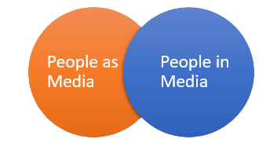
People Media

Slide 61
People Media
What is the commonality?
Both are people media which means they are involved in the use, analysis, evaluation and production of media and information.
Both are people who provide information.
What are the differences?
People in Media are media practitioners which means they are media related professionals while people as media are not media practitioners but rather media users.

Slide 62
People Media
People in Media
Media practitioners who provide information coming from their expert knowledge or first- hand experience of event.
They are those who control media. These are people behind any forms of media—such as ads, videos, etc—that access information and acquire new knowledge.

Slide 63
People Media
People as Media
People who are well-oriented to media sources and messages and able to provide information as accurate and reliable as possible.
They act as the media itself. They are the people who give and/or share information to other people for them to have new knowledge.
Notes:
Social Media Influencers:
Individuals who have gained a significant following on platforms like Instagram, YouTube, or Twitter can be considered as media channels. They use their personal brand to share content, promote products, and influence their audience.
Bloggers and Vloggers:
People who maintain blogs or vlogs (video blogs) create and share content on a variety of topics. Their personal experiences, opinions, and perspectives are presented in a media format, reaching and engaging with their audience.

Slide 64
Interactive Media Platform
o Mobile Apps
o 3D TV
o Video Games
o Web Design and Production
o Virtual Reality and Immerse Environment
o Social Media
o Multi-player online game

Slide 65
Ways of Interacting with social media
Online shopping - compare prices; compare features of similar items; add to cart; choose payment type; track delivery; get advice from experts; search products; check local availability; get product recommendations.
Online gaming - choose a game; play with computer; play with others; choose a level, in-game customization, etc.
Online classes - interact with content; interact with instructors; interact with classmates.
Chat - group chat; search groups; search friends; translate language.
News and information - exchange information; give reaction; news on demand; monitor views.
Videos - choose your own adventure; get multimedia content; experience game elements.

